Slide 1

A measure of Audience Popularity Insight by Category
10/03/2023
Profit, Audience scores, and yearly Productions
See the Report in Power BI
Parisa Azimivahdat
DATA SKILLS at JUSTIT Boot Camp

Slide 2
Format
Quantitative Data
New Columns multiplying ‘Profit’ and ‘Worldwide.Gross’ by 1m-multiplier, formatted as currency in $, thousands separator by comma and no decimals to display data clarity and origin.
‘Audience Score’ and ‘Rotten Tomatoes’ with 2d. and % sign for each data value for better visibility in the final visualisation.
‘Profitablity’ rounded to 2d.
Qualitative Data
ID-Column added.
Renamed headings to avoid ambiguity

Slide 3
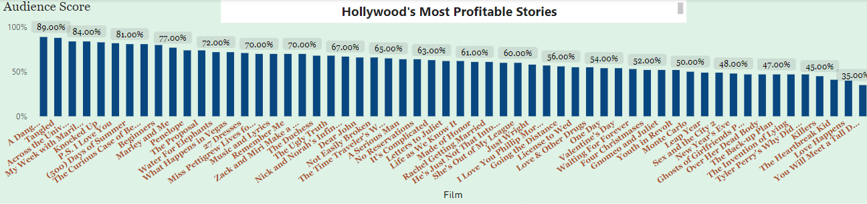
Each Film scored by Audience The Audience score is visible as % of the total in a ‘Stacked Column Chart’ Pros: Film titles selected for more information on: profitability figures Genre Number of rotten tomatoes

Slide 4
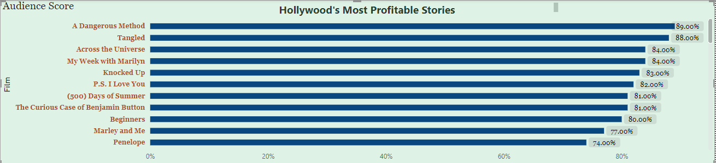
A Clustered Bar Chart The scores are displayed in parts and a scroll-bar is going down to the next part of the chart. Cons: Viewers cannot easily compare all the films’ results easily.

Slide 5
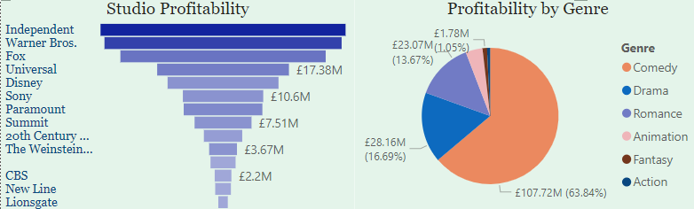
Funnel Pie Chart Highlights profitability for each Film Studio Shows genre parts and profitability in $ and %

Slide 6
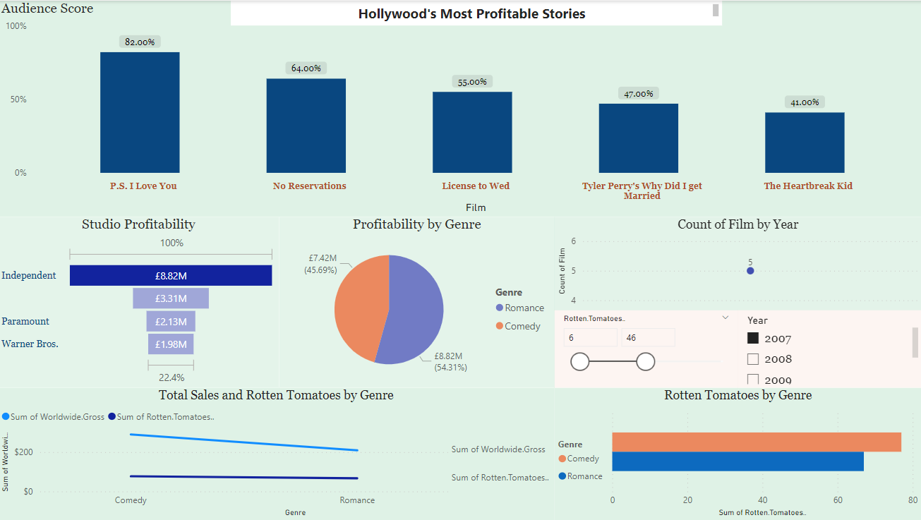
The year-slicer is used to select information about the production results by year. The count of films by year is visible in the chart above the slicer.

Slide 7
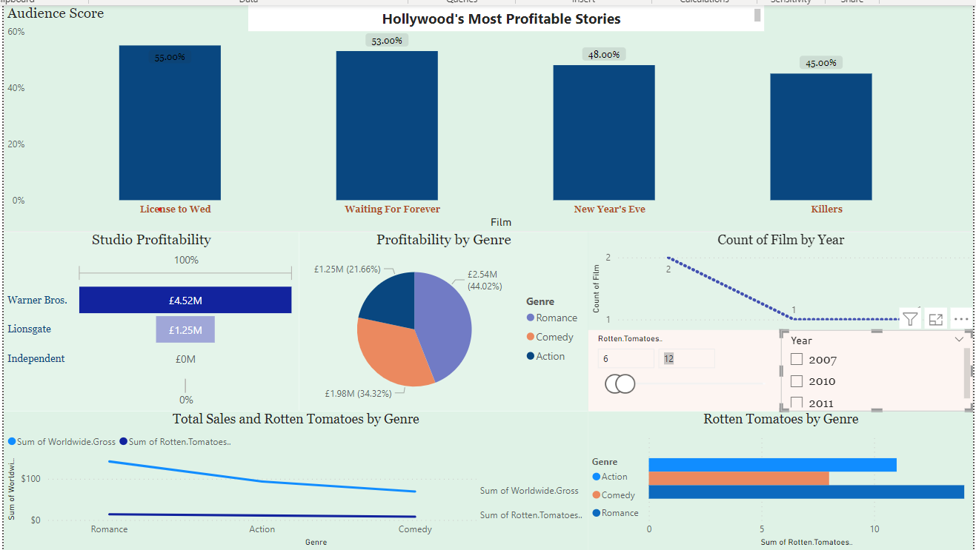
A slicer for the count of rotten tomatoes selects related data.

Slide 8
